Slide 1

Agile Scrum Workshop
Laura Poe
CEO/Owner
DigiTek LLC
August 25, 2017

Slide 2
Professional Profile

Slide 3
Professional Profile
Successfully led 15+ Agile teams for large corporations
20 years of industry experience
Manufacturing
Financial
Government
Cyber Security
Employee Management Coaching for Philip Morris IT Senior Management Team
Teaching Experience – John Tyler Community College, Strayer University
Curriculum Design - Virginia Commonwealth University

Slide 4
Agenda
9:00 – 9:30 Arrival & Introductions
Training Goals
9:30 – 10:30 Making the Case for Agile Project Methodology
Agile versus Waterfall: What’s the Difference?
Pros & Cons
Agile Team Structure & Roles
10:30 – 10:40 Break
10:40 – 12:00 Agile SCRUM
Team Norms
Planning Sessions
Retrospectives
Story Development
Capacity & Burn Down
12:00 – 1:00 Lunch
1:00 – 2:30 Agile Tools Review & Hands On
GitHub Exercises
2:30 – 2:40 Break
2:40 – 4:00 Continuous Integration / Continuous Deployment
Automated Test Driven Development & Behavior Driven Development
Agile Challenges – Security, Change Management, Dependencies
4:00 – 4:30 Resources, Certifications, Industry Requirements
Training Retrospective
Notes:
For session, a projector and 2 flipcharts with markers are needed.

Slide 5
Training Objectives
Understand Agile Scrum framework and team roles, responsibility, and project lifecycle
Enable participants to apply Agile Scrum principles and concepts to Management Information Systems coursework

Slide 6
What you should understand after the workshop
Scrum is for targeted and iterative development, accomplished through self-organizing teams
Scrum is not appropriate for all projects; waterfall may better suit current needs
Self managed teams are extremely productive, work closely together with the customer to create the most beneficial business solutions

Slide 7
Methodology Comparisons
Agile
Waterfall
Iterative
Features → Epics → Stories → Tasks
PI Planning → Sprints
Flexible release dates based upon team capacity
Cross-functional teams
Full transparency
Daily project status updates
Sequential
SDLC
Gantt style project plans
Pre-determined and fixed Production Release Date (Go-Live)
Large project teams with centralized skills
Weekly project update meetings

Slide 8
Impact of requirements or design changes using Waterfall
Work longer hours to ‘get it right’ and avoid late-term changes
Cost of change
Requirements must be nailed down to avoid change
Analysis Design Coding Testing Ops

Slide 9
Advantages of the Waterfall Methodology
Disadvantages of the Waterfall Methodology
Meticulous record keeping, e.g. requirements definition, design documents, testing strategies
Detailed records allows for the ability to improve upon the existing program in the future
Stakeholders know what to expect and when to expect it
Other known factors: size, cost, and timeline
End product is known
Strong documentation allows for minimal project impact for team member turnover
Full security testing performed prior to go-live
Once a step has been completed, developers can’t go back to a previous stage and make changes without impacts to the go-live date
Relies heavily on initial requirements
If a requirement error is found, or a change needs to be made, the project has to start from the beginning with all new code.
The whole product is only tested at the end
If bugs are written early, but discovered late, their existence may have affected how other code was written
Schedule often outweighs testing
The temptation to delay thorough testing is often very high, as these delays allow short-term wins of staying on-schedule
The overall project plan doesn’t take into account a client’s evolving needs
Scope creep, evolution of business needs can cause the project to come in late and impact budget

Slide 10
Advantages of Agile
Disadvantages of Agile
Allows for changes to be made after the initial planning
Client changes are expected
Scope changes can be easily incorporated
Work is prioritized during planning sessions based on team capacity
Team members are not expected to work additional hours to meet deadlines
Deadlines are based on team capacity to complete the work
Testing is done during the iterative Sprints
Allows for bugs to be discovered, and customer feedback to be incorporated into the design before the next sprint is run
Smaller production releases
Unmanaged sprints could lead to never-ending work with no end date in sight
Rapid delivery often leads to lack of standards for testing
Cyber security impacts as security often becomes an afterthoughts

Slide 11
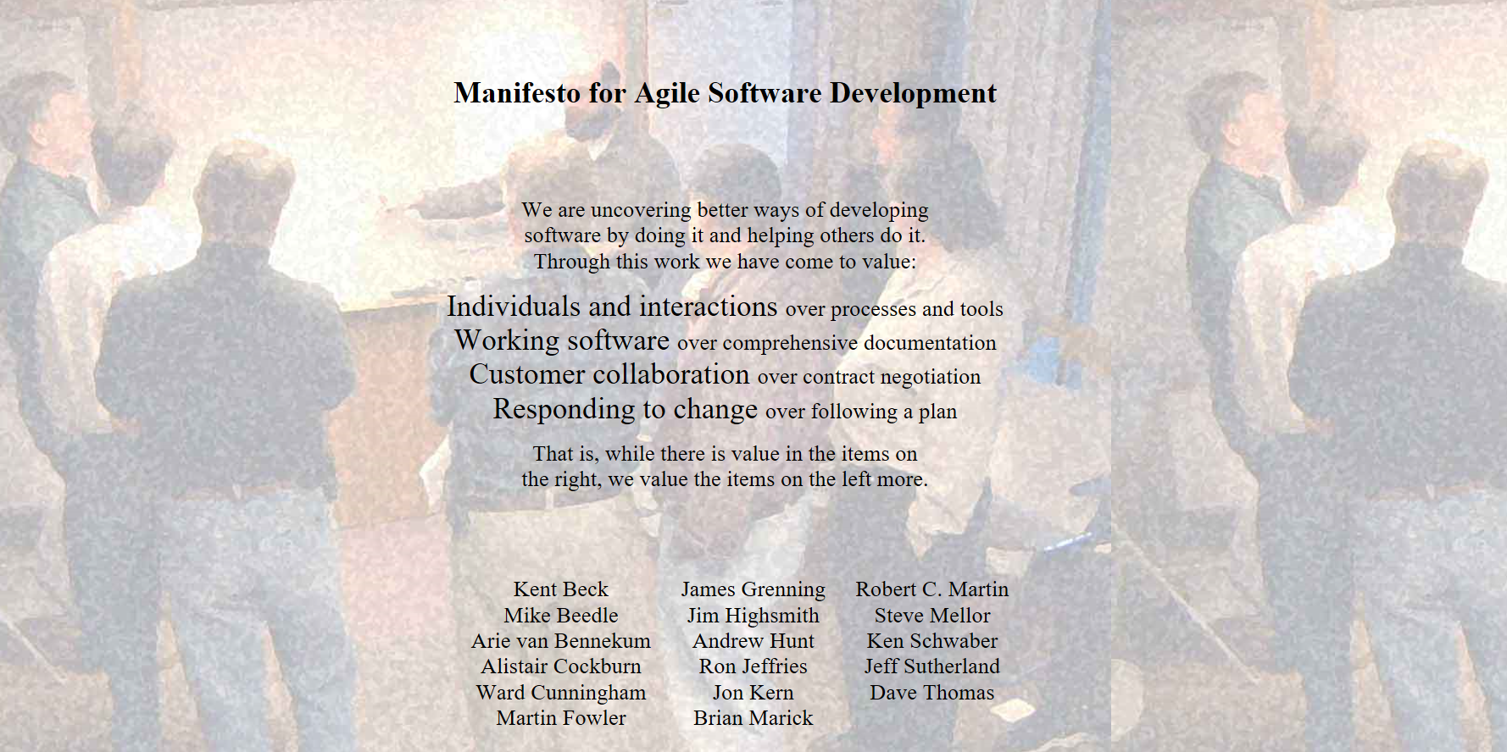

www.agilemanifesto.org

Slide 12
Principles behind the Agile Manifesto
Our highest priority is to satisfy the customer through early and continuous delivery of valuable software.
Welcome changing requirements, even late in development. Agile processes harness change for the customer's competitive advantage.
Deliver working software frequently, from a couple of weeks to a couple of months, with a preference to the shorter timescale.
Business people and developers must work together daily throughout the project.
Build projects around motivated individuals. Give them the environment and support they need, and trust them to get the job done.
The most efficient and effective method of conveying information to and within a development team is face-to-face conversation.
Working software is the primary measure of progress.
Agile processes promote sustainable development. The sponsors, developers, and users should be able to maintain a constant pace indefinitely.
Continuous attention to technical excellence and good design enhances agility.
Simplicity--the art of maximizing the amount of work not done--is essential.
The best architectures, requirements, and designs emerge from self-organizing teams.
At regular intervals, the team reflects on how to become more effective, then tunes and adjusts its behavior accordingly.

Slide 13
The Point of Scrum
Traditional
Scrum
DONE
DONE
DONE
DONE
DONE
DONE
- Development team must be able to produce a potentially shippable product increment EVERY Sprint.
- The Product Owner must inspect and adapt to optimize the ROI every Sprint (review backlog to complete features with highester ROI.
- Scrum Master must remove impediments that are preventing the work from being “done”.

Slide 14
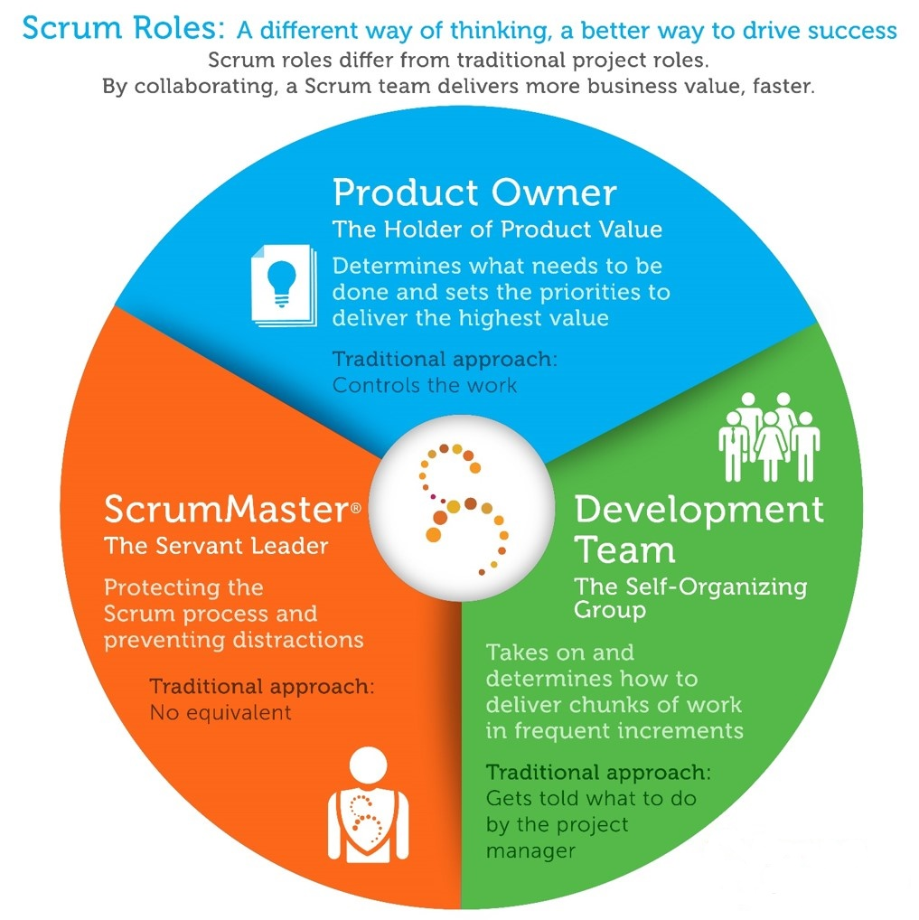
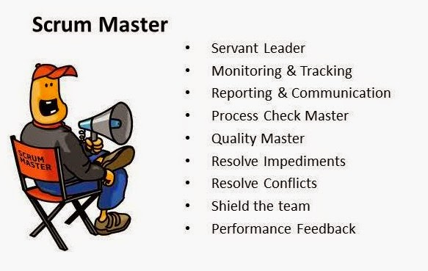
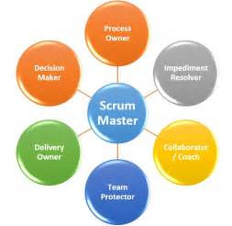

Slide 15
Business Knowledge
Process Knowledge
Technology Experts
PRODUCT OWNER
Vision and goals
Select features based on ROI
Financial voice
Provide domain knowledge
Keep other stakeholders updated on progress
SCRUM MASTER
Sets project rhythm
Facilitate
Remove impediments
Support PO and Dev team with process & preparations
Provide metrics and statistics - give a basis for decision-­making
DEVELOPMENT TEAM
Cross-functionaI, multi-discipline
Self-organizing, empowered
Deliver quality product increment every sprint
Follows agreed-upon game rules to ensure long-term robustness of products

Slide 16
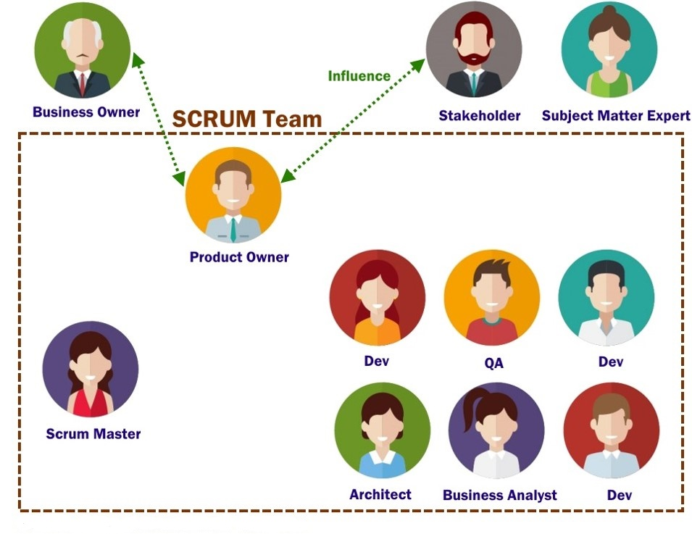

Slide 17
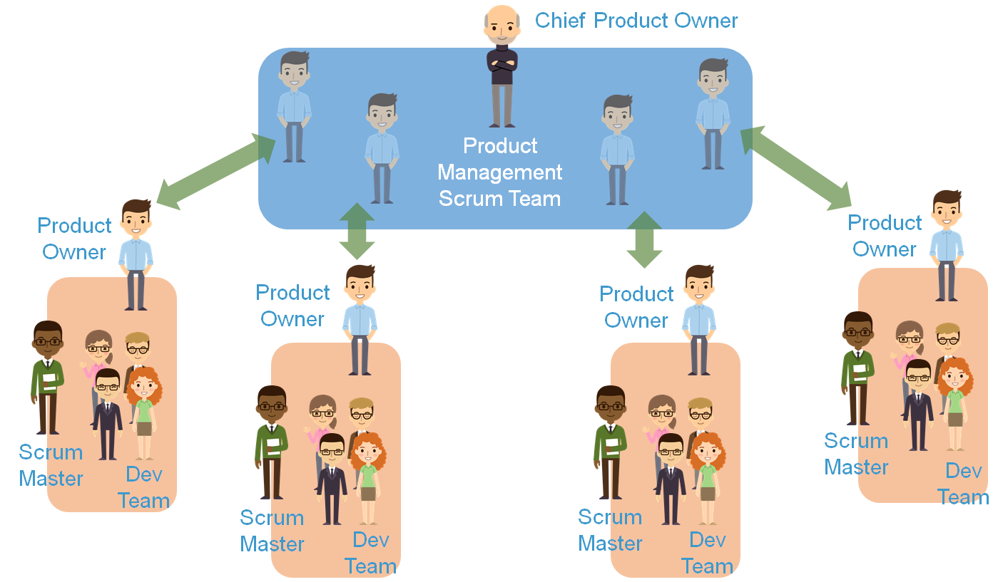

Slide 18
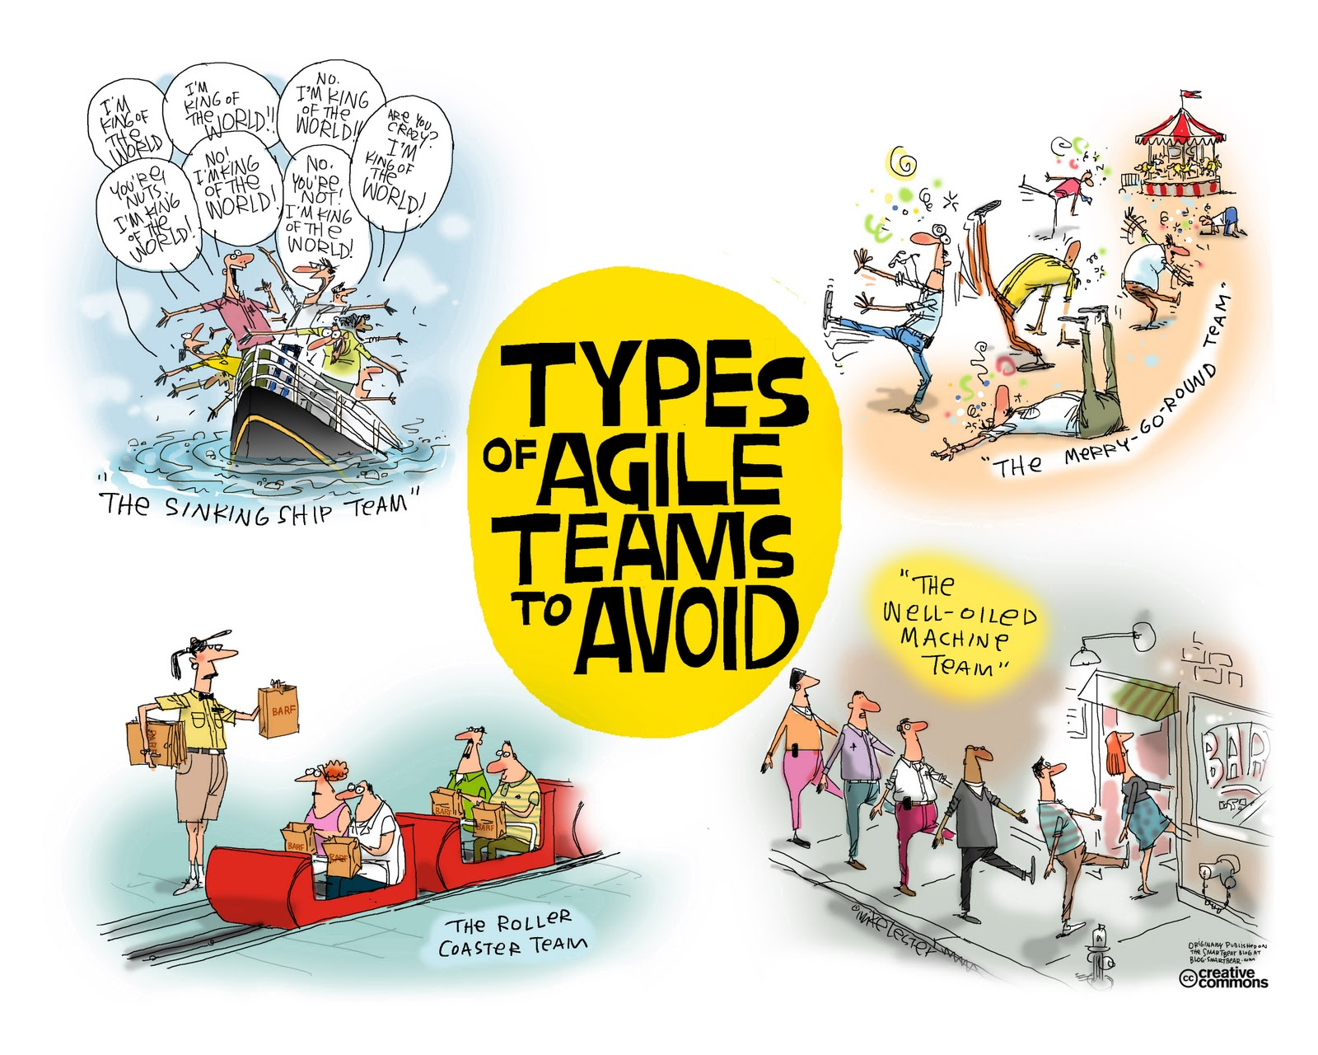

Slide 19
What is Scrum?
Scrum is an Agile project management methodology approach for iterative development
What is iterative development?
Small pieces of software development that can be deployed at the end of each sprint
Each piece of software code builds upon the next until the full set of changes have been implemented

Slide 20
Benefits of Agile Scrum
Reduced costs
Higher quality software code
Faster delivery
Happy customers

Slide 21
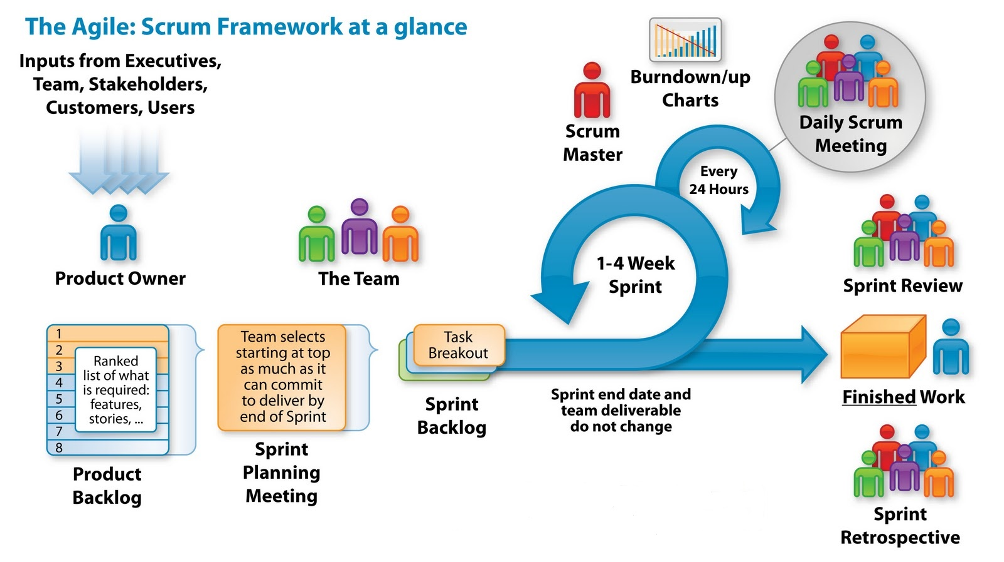

Slide 22
Agile Ceremonies
Release Planning – 1-2 days
Sprint Planning – ½ - 1 day
Sprint – 2-3 weeks
Daily Scrum (stand-up) – 15 minutes
Sprint Review – 2-4 hours
Sprint Retrospective – 1-2 hours

Slide 23

Why is Scrum so difficult?
It’s NOT
Setting up cross-functional teams with the right skill set
Organizational processes may need to be changed
Finding a product owner and scrum master to lead the teams
Creating a product backlog (stakeholder input and frequent communication between the business and product owner )
Culture of multi-tasking
Fail safe!
Estimation
Consider existing product support, not just new development
May need to set aside time each sprint for production support activities
Long-term planning – sprints focus on the short term planning efforts, but there needs to be a roadmap
Coordination with other teams – conflicting priorities, dependencies
Time must be budgeted more strictly and add in flex time for development opportunities, research, team activities and celebrations, etc.

Slide 24
Reduce Risk → Iterative, Incremental Methods
Why release incremental changes iteratively?
Reduce risk by providing transparency
Allow for adaptation
IKIWIS (I’ll know it when I see it) – demos
Make better informed decisions and changes as needed
Iteration 1
Iteration 2
Iteration 3
Iteration 4
Iterations are similar to phases in a project (think Sprints).
Increments are software development features that can be released after each iteration.

Slide 25

Create a Product Vision Statement
What is being developed?
Why are we funding it?
Who is the customer of the product?
External
Internal
What is the benefit / ROI?
How do we measure against our competitors?

Slide 26
Product Vision Exercise
Pick a team of 5 and create an idea for a new app
Write your vision statement using the following:
Who is the customer?
Name the product
What is the product’s category?
What is the main benefit provided by the product?
Who are the competitors?
How is this product differentiated from other similar products?

Slide 27
Create a Product Backlog
What Goes in the Backlog
List of features and product capabilities the customer wants developed broken down into actionable pieces of work
One list for the entire team
When new work is identified, it goes into the backlog.
Action
Prioritize the backlog
Select capabilities to include in upcoming sprints
Define the criteria for success for each item – definition of DONE

Slide 28
User Stories
Examples:
As a developer, I need an automated unit test framework so that I may test my code and detect
problems earlier.
As an analyst, I need to determine the business rules for adding new contact information for
veterans.
As a job seeker, I need the capability to post my resume to the website.
As a customer, I want to order groceries from my phone.
As a customer, I want my online grocery order to have the option for home delivery.

Slide 29
ESTIMATE! ESTIMATE! ESTIMATE YOUR STORIES!
1 2 3 5 8 13 21 34…
Based on hours or complexity, but the form of measurement is determined
BY THE TEAM.
Stories should be small enough to complete in a single Sprint.
*Is there a difference in the estimate if acceptance criteria is “support 1000 users” vs. “support 10 million users”?

Slide 30
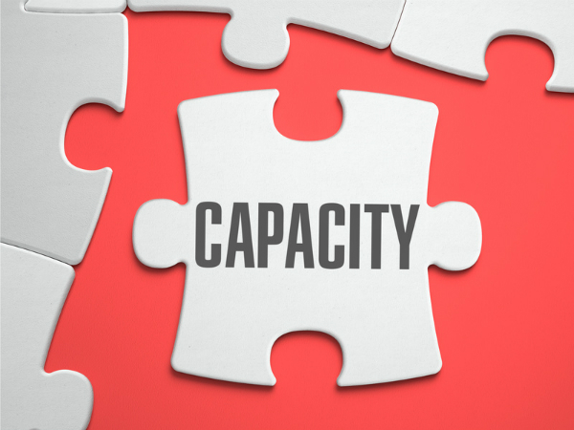
Sprint 1 –
6 team members
35 hours/week each
Total working capacity =
210 hours
Sprint 2 –
6 team members
35 hours/week each
BUT…
1 team member is on vacation
Total working capacity =
175 hours
Estimated story points should NOT exceed team capacity!

Slide 31
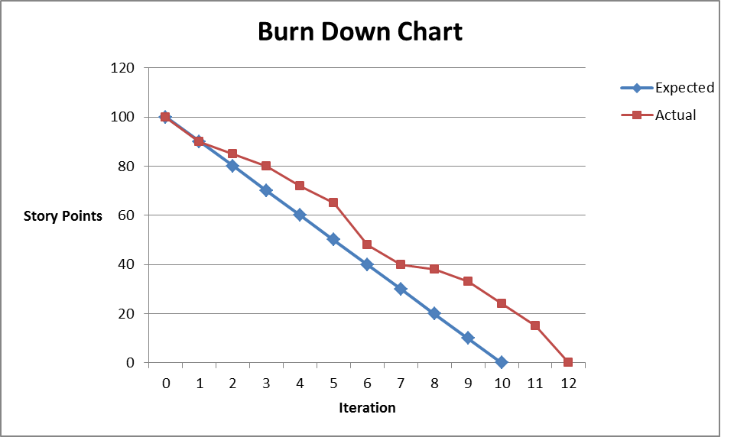

Slide 32
Daily Stand-Ups / Scrums
Each team member provides a quick update on their work:
What did you accomplish yesterday?
What will you accomplish today?
Do you have any impediments preventing you from completing your work?
The stand up meeting assumes priority over all other meetings
Other topics outside of the 3 questions are placed in the parking lot for follow up after the Stand up meeting
The stand up is NOT the only time the team collaborates each day
Team members must update their board BEFORE the stand-up each day so that the current status is reflected during the stand-up.

Slide 33
Group Exercise

Slide 34
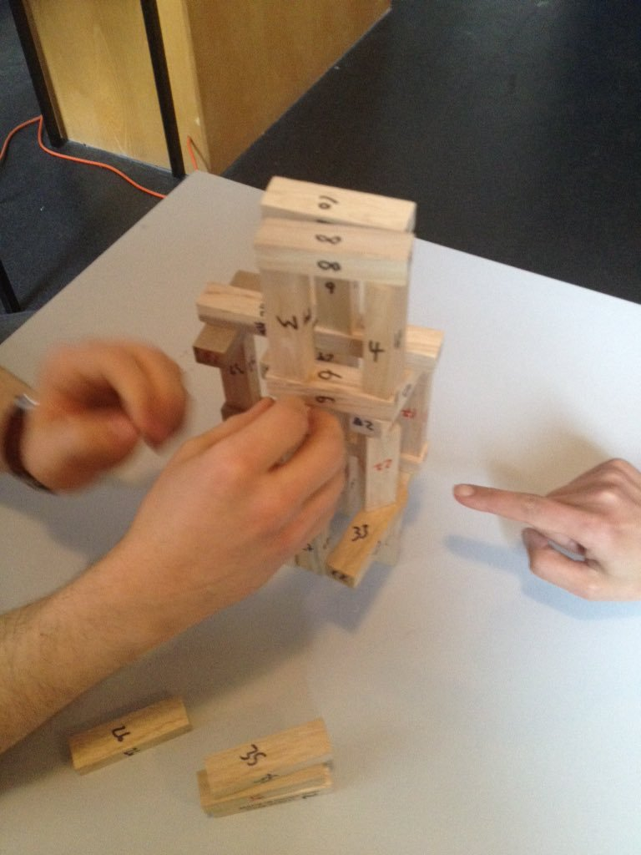
Jenga Scrum Game
Identify the following: 1) Scrum Master to facilitate the stand-up meetings, 2) Product Owner to serve as the stakeholder with the business 3) Two to five team members who will build the product and one tester
Determine your team norms: what do you consider important as a team (punctuality to the meetings, a safe environment where ideas can be expressed openly)
Sprint 1: Build a tower that is at least three stories tall and uses all of the blocks. The tester is given four numbers of ‘problem blocks’ which must be removed. This should be randomly picked by you, or a random number generator, or from others. The requirements still stand, that the structure should be three stories tall.
You are given 10 minutes to complete Round 1
When the time is up, the Scrum Master will hold a 3-minute stand-up to obtain progress from each team member (what I did, what I plan to do, any impediments I am facing)
The Scrum Master will raise any impediments to the trainer
Repeat the exercise one more time
If you have successfully completed the task, your product owner will need to ‘approve the product
Team Retrospective

Slide 35
Adding user stories and estimates
Using your knowledge from Sprint 1: Create user stories (these are your requirements) and estimate the points based on time or complexity (no right answer). *Write your user stories down for later use.
Sprint 2: Build a tower that is at least three stories tall and uses all of the blocks. This time, the developer is given the blocks in three separate batches: 1-12, 13-24, and 25-36. After each batch is used, the tester tells the developer about the two ‘problem blocks’ in each batch and modifies the structure accordingly.
You are given 5 minutes to complete Round 2
When the time is up, the Scrum Master will hold a stand-up to obtain progress from each team member (what I did, what I plan to do, any impediments I am facing)
The Scrum Master will raise any impediments to the trainer
Retrospective
Sprint 3: The requirements are as before, and the blocks are done in the three batches again, but this time the tester can tell the developer which are the ‘problem blocks’ as they are prepared for use.

Slide 36
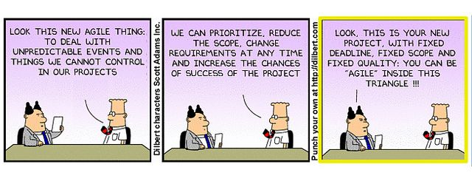
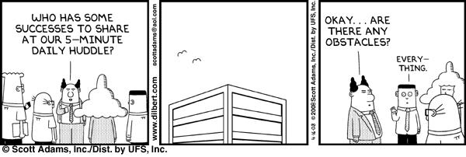
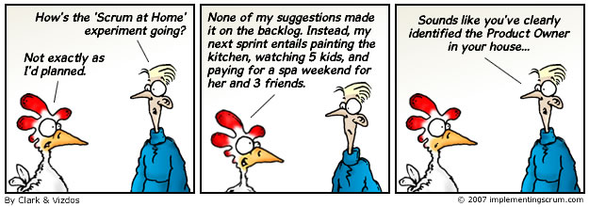
Scrum Humor

Slide 37
Agile Scrum Commonly Used Tools
Version One - https://www.versionone.com/
Robust, highly structured framework with integration to automated testing tools
Must purchase licenses
JIRA - https://www.atlassian.com/software/jira/download
More flexibility than Version One, requires SQL knowledge for managing groups/stories/reporting
Must purchase licenses
GitHub with Zenhub plug-in - https://github.com/
Integration with almost every tool for controlling versions of code or documentation
Free, open source
Github is often used with Eclipse for coding, testing framework, diagramming, and modeling

Slide 38
Agile Management Tool
GitHub provides version control of code and documentation
GitHub comes with an "out of the box“ issue tracking system, but it’s fairly limited. As a result, there have been several GitHub add-ons developed to better support Kanban and Scrum Agile methodologies in GitHub.
ZenHub add-on for Agile Project Management
Zenhub displays issues in the familiar Scrum Board format to help visualize and track the team’s work through the development life cycle
Allows for the creation of Epics in order to group issues related to a common initiative

Slide 39
How to Access ZenHub (hands-on)
In order to access ZenHub, you first need a GitHub account:
Create a GitHub user account at https://github.com
Enable two factor authentication (2FA)
Once your GitHub setup is complete, download the ZenHub add-on:
Chrome add-on
Firefox add-on - get ZenHub by clicking the download button on ZenHub.com while using Firefox. Just sign in with GitHub, and you're good to go!
Note: The add-on is not available in Internet Explorer. Currently Chrome and Firefox are the only supported browsers for ZenHub.

Slide 40
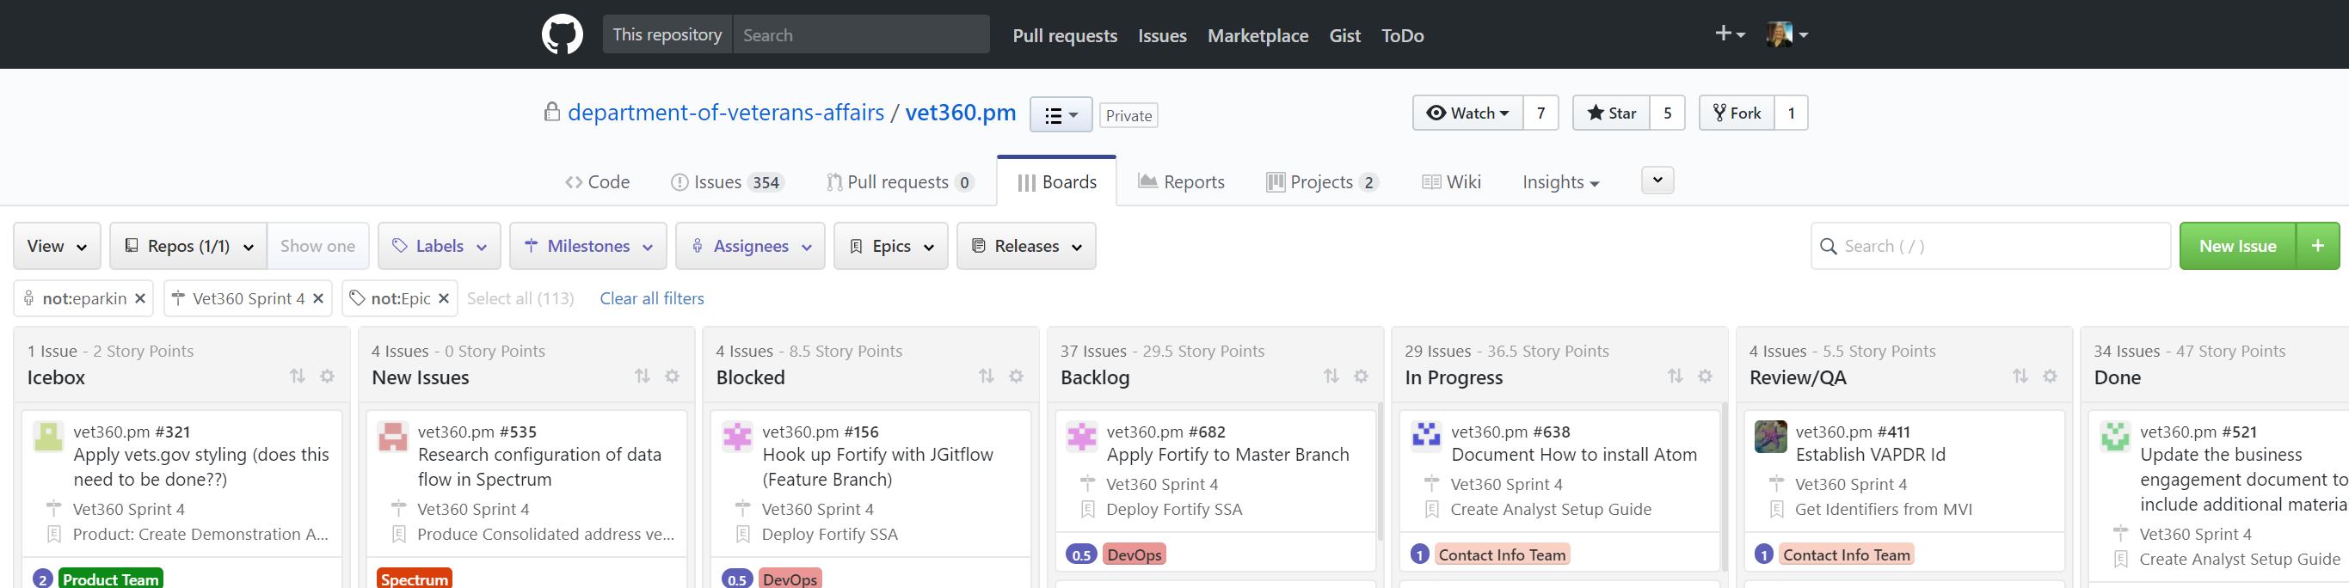
Creating a New Epic in ZenHub
From the ZenHub Board (or from the Issues Tab), click New Issue.
Enter a meaningful Title
In the body of the issue, enter the story (using story format) and the acceptance criteria for the for the Epic.
In the right navigation pane, select the following:
Pipeline (all new issues default to the New Issues Pipeline. Please assign to the correct pipeline – typically Backlog (future work) or In Progress (current work))
Assignee – can assign up to 10 team members
Labels
Required Labels:
Assign the Epic label
Assign the correct work stream label
Milestone – commonly used for tracking sprints
Estimate – this is assigned during story grooming
Once all labels have been assigned, click Create New Epic
If there are existing issues (tasks) that need to be added to the Epic, select the issues

Slide 41
Action Item
Take your stories/issues from the JENGA exercise and transfer them into GitHub
Ensure all stories have an accurate description or definition of DONE
All stories should be linked to their appropriate Sprint
All stories should have the proper status

Slide 42
SAFe Scrum XP

Slide 43
XP
eXtreme Programming
Design is simple and clean
Immediate feedback on day 1 by testing software while coding
Implement changes immediately
Customer is on-site and available
Code must be written to agreed standards.
Test Driven Development - Code the unit test first
All production code is pair programmed
Two programmers working at a single computer on the same code simultaneously
Only one pair integrates code at a time
Continuous integration

Slide 44
Keeping Pace
Technology is increasingly complex and changing constantly
Prior development practices are not keeping pace – Waterfall, RAD, iterative, incremental
Agile was developed for small teams
SAFe was designed for Agile teams using Lean practices

Slide 45
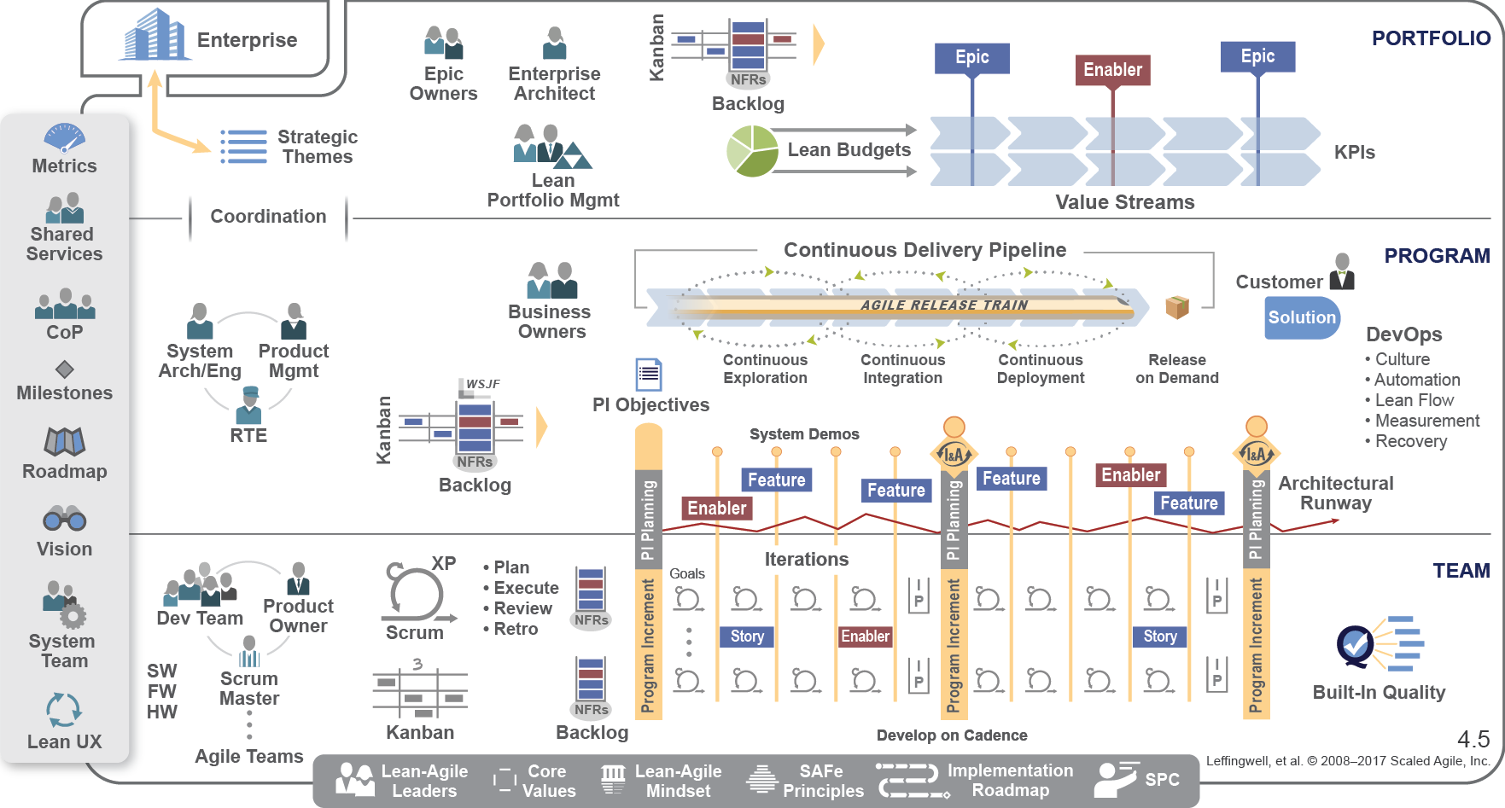

Slide 46
Agile Release Trains
5 – 12 Agile teams that plan, commit, and execute together on value stream goals
Value streams are similar to lines of business (Order to Cash, Application Security, Customer Acquisitions)
Deliver PI (Program Increment) every 8-12 weeks
Program Increment (PI) Planning Program Increment (PI) planning - a cadence-based, face-to-face event that serves as the heartbeat of the Agile Release Train (ART), aligning all the teams on the ART to a common mission and vision.

Slide 47
PI Planning
PI Planning (aka release planning) sessions are fixed time cadence, usually quarterly
2 days, in person
Product manager communications vision and roadmap
Agile development teams own story planning and estimates
Teams work together to determine inter-dependencies
Inter-dependencies may impact team’s capacity
Team 1 needs Team 2 to perform some network changes
Team 1 cannot finish the product without Team 2’s completion
Team 2 has network change requests from 3 other teams and is over capacity for the current sprint
How does this situation affect Team 1?
PI Planning sessions help teams identify the features they need to complete, translate them into stories, and communicate with other teams for dependencies

Slide 48
Release Train Engineer (RTE)
Supporting Roles
Uber-Scrum Master
Person responsible for organizing the PI Planning sessions
Facilitates Scrum of Scrums
A higher level scrum where all scrum masters in the value stream come together to discuss any impediments they need help with (prioritization from senior leadership)
Escalates impediments and helps manage risk
Drives program-level continuous improvement

Slide 49
Program Team
Supporting Roles
Per value stream
Includes product managers who own the vision for the value stream and define and prioritize the program backlog

Slide 50
System Team
Supporting Roles
Build and support infrastructure
Assist with test automation strategies
Support integration activities
Integration testing
Performance testing
Support sprint demos

Slide 51
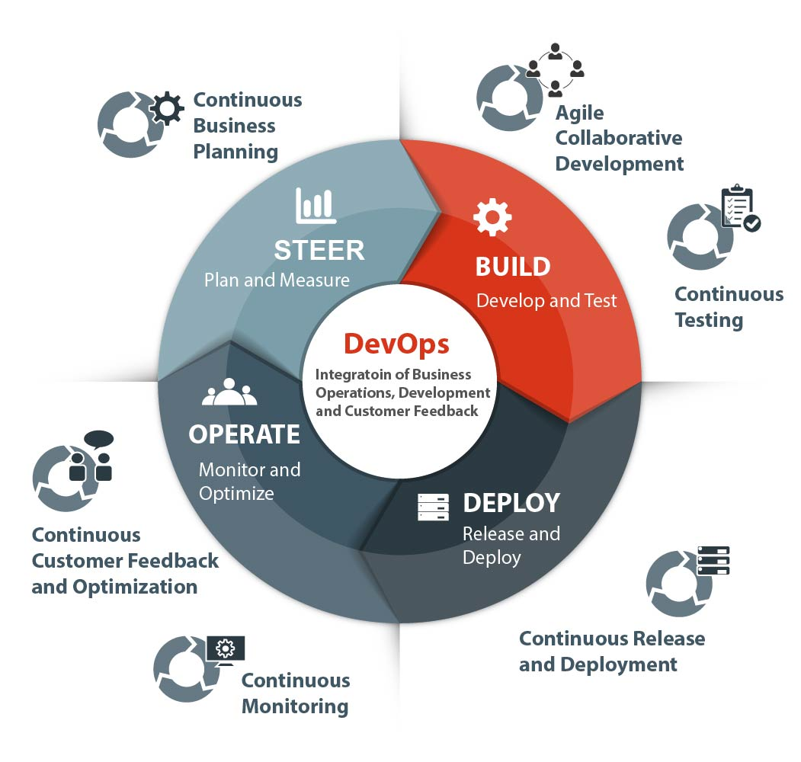
DevOps
Build pre-prod environments for staging
Ensure environments have matching code
Automated deployment
Version control

Slide 52
Continuous Integration / Continuous Deployment (CI/CD)
Part of DevOps strategy
“Continuous Delivery (CD) is a software strategy that enables organizations to deliver new features to users as fast and efficiently as possible. The core idea of CD is to create a repeatable, reliable and incrementally improving process for taking software from concept to customer.” (devops.com)
Build Automation and Continuous Integration
Test Automation
Deployment Automation

Slide 53
Deployment Pipeline
Automated implementation of the process to build, deploy, test, and release
Every configuration, source code, network, data, or other technological change triggers the creation of a new instance of the pipeline
Before CI/CD – manual testing, different configuration depending on the environment, filesystems with different layouts, releases that may take hours
After CI/CD – automated testing, limited errors, congruent

Slide 54
DevOps Tools
GitHub
Docker
Jenkins
Chef
Ansible

Slide 55
Automated Acceptance
Originates in eXtreme Programming in the practice of Test-Driven Development (TDD)
Instead of passing requirements to the developer without time for feedback, the developer and stakeholder collaborate to write automated tests that express the desired outcome
Not unit tests (build the thing right)
Acceptance tests (build the right thing)

Slide 56
Behavior-Driven Development (BDD)
An extension of TDD
Write acceptance tests as examples that anyone can read and understand
Ubiquitous language that everyone can understand
Tools that can transform the language into testable code

Slide 57
Cucumber & Gherkin
Gherkin is the language that Cucumber understands. It is a Business Readable, Domain Specific Language that lets you describe software’s behavior without detailing how that behavior is implemented.

Slide 58
Gherkin Feature File - Example
1: Feature: Some terse yet descriptive text of what is desired
2: Textual description of the business value of this feature
3: Business rules that govern the scope of the feature
4: Any additional information that will make the feature easier to understand
5:
6: Scenario: Some determinable business situation
7: Given some precondition
8: And some other precondition
9: When some action by the actor
10: And some other action
11: And yet another action
12: Then some testable outcome is achieved
13: And something else we can check happens too
14:
15: Scenario: A different situation

Slide 59
Feature: Adding Numbers
Scenario: Add two numbers
Given the input "2 +2"
When the calculator is run
Then the output should be "4"

Slide 60
How do all the tools work together?
GitHub – one tool for team planning and managing code changes
ZenHub (an extension of GitHub that allows you to see your scrum board more easily)
GitHub Desktop for easily uploading code changes and version control
Eclipse – leverage for diagramming, creating feature files (e.g. using Gherkin), or programming
Cucumber – download feature files stored in GitHub and running the automated tests

Slide 61
Questions and Answers

Slide 62
Appendix
https://help.github.com/articles/create-a-repo/

Slide 63
Adventure Works: The ultimate source for outdoor equipment

